Slide 1
Ezekiel 40-44 The “Future Temple” (Part 1)
“Declare to the house of Israel all that you see.” (40:4b)

Slide 2
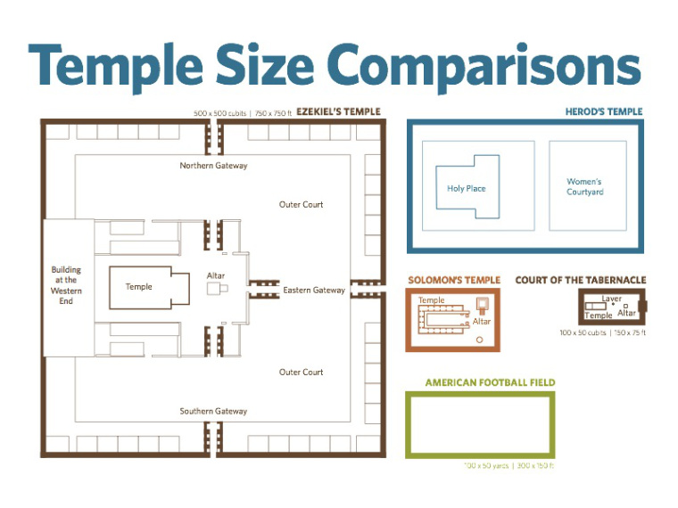
The “Future Temple” (Ezekiel 40-43)
The Vision Begins (40:1-4) “Like”
Measurements of the Temple Outside (40:5-49)
The Temple Proper (41:1-26)
The Temple Outbuildings (42:1-20)
God’s Glory Fills the Temple (43:1-12)
The Temple Altar (43:13-17)

Slide 3
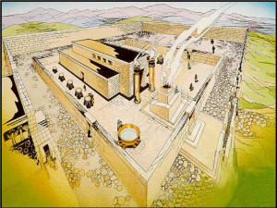
God’s Glory Departs the Temple (Ezekiel 8-11)
God’s Glory Departs the Temple (Ezekiel 8-11)
Vision begins (8:1-4)
From the Temple to the Threshold (9:3, 10:4)
From the Threshold to the Gate of the Temple (10:18-19)
Out of the City to the East (11:23)
God’s Promise (Ezekiel 11:17-20)

Slide 4
God’s Glory Fills the Temple (43:1-12)
God’s Glory Fills the Temple (Ezekiel 43)
Coming from the East (43:2)
Into the House (43:4)
Filled the House (43:5)
God’s Promise (43:6-9)
Reasons for describing the “Future Temple” (43:10-12)

Slide 5
The “Future Worship” (Ezekiel 43-44)
Statues/Ordinances of the Altar (43:18-27)
Statues/Ordinances of the Gate (44:1-3)
Statues/Ordinances of the House (44:4-14)
Statues/Ordinances of the Ministry (44:15-31)
What “qualified” the priests to serve? (44:10, 15)
What were they to teach the people? (44:23, 22:26)
God Is Holy!

